Slide 1

Detect Toxic Comments
DSI7 Capstone Project
Abdulelah Alkesaiberi
Norah Alsharif
Sarah Aljudaibi

Slide 2
01
04
System Prototype
Problem Statement & Solution
02
05
Data Exploration
Challenges
03
06
Machine Learning
Conclusion & Future Works

Slide 3


Hanna Smith
a victim of cyberbullying
“As I sit here day by day I wonder if it’s going to get better. I want to die, I want to be free. I can’t live like this anymore. I’m not happy” Hanna Smith

Slide 4

Problem
83%
Teens
10% - 20%
experience cyberbullying regularly
41.5%
Memes
connected to social media
negative comments
Cyberbully
Post

Slide 5

Solution
AI model that can detect the toxicity of the comment or sentence and allowing the server to prevents it from being sent.

Slide 6

The Used Data
Training Dataset
comment_text | toxic | severe_toxic | obscene | threat | insult | identity_hate
String | Integer | Integer | Integer | Integer | Integer | Integer
It contains 223549 rows and 8 columns.
Validation Dataset
id | comment_text | lang | toxic
ID | String | String | Integer
It contains 8000 rows and 4 columns.
Testing Dataset
id | content | lang
ID | String | String
It contains 63812 rows and 3 columns.

Slide 7

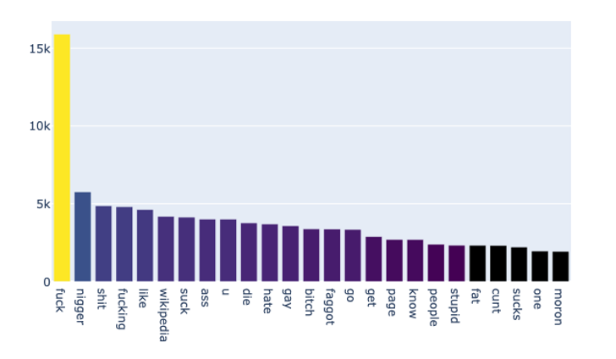
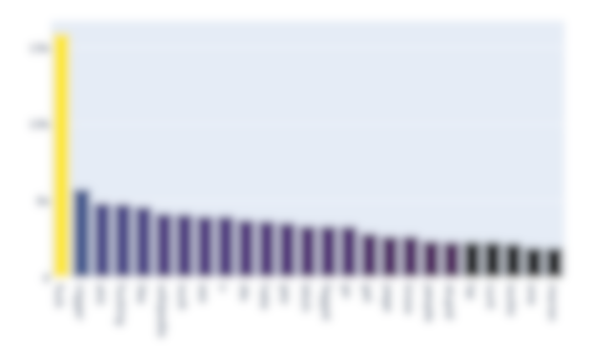
Top 25 common use toxic words
This image was covered do to the violent words

Slide 8

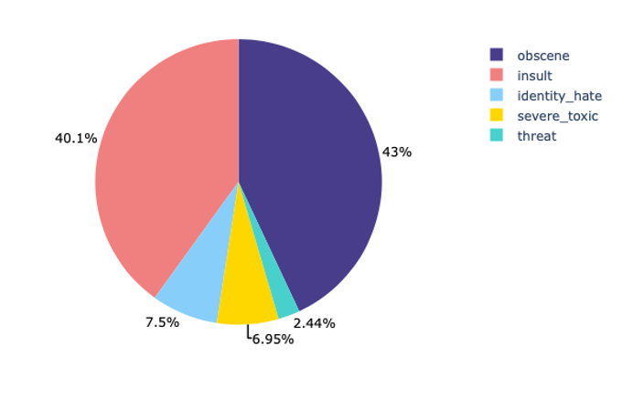
Categories Of a Toxic Word
40.1 %
43%
7.5 %
2.44%
6.95%

Slide 9

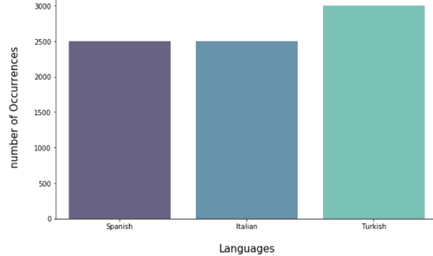
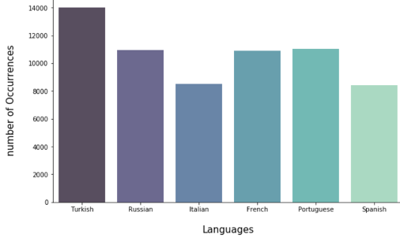
Languages
Validation Data
Testing Data

Slide 10

Machine Learning
Transformers
XLM-R
Recurrent Neural Network
Transformers
Transformers
Bi-directional LSTM
Bert
DistilBert

Slide 11
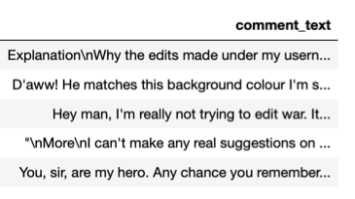
Bi-LSTM Model: Long Short Term Memory
Preprocessing
Tokenizer
Word embedding
Modeling
Our approach is to remove the emojis and symbols from the datasets to improve the performance of the model

Slide 12

Bi-LSTM Model: Long Short Term Memory
Preprocessing
Tokenizer
Word embedding
Modeling
Tokenize the comments, the tokenizer job is to split the sentence into words to help us to map each word to unique vector.

Slide 13
Bi-LSTM Model: Long Short Term Memory
Preprocessing
Tokenizer
Word embedding
Modeling
array([[ 0. , 0.0231 , 0.017 , 0.0157, ..., 0.13015001, -0.18317001, 0.1323],[-0.0175 , -0.2189 , 0.0353 , ..., 0.082745 , 0.097801 , 0.25044999],[-0.25909999, -0.2976 , -0.0327 , ..., 0.058326 ,-0.22751001, -0.34209001],[-0.25909999,-0.2976 , -0.03ة](
Taking the words from our previous step and map every word to static vector and we combine two pre-trained word embedding methods (GloVe+ FastText) to get benefit from combine two this methods

Slide 14
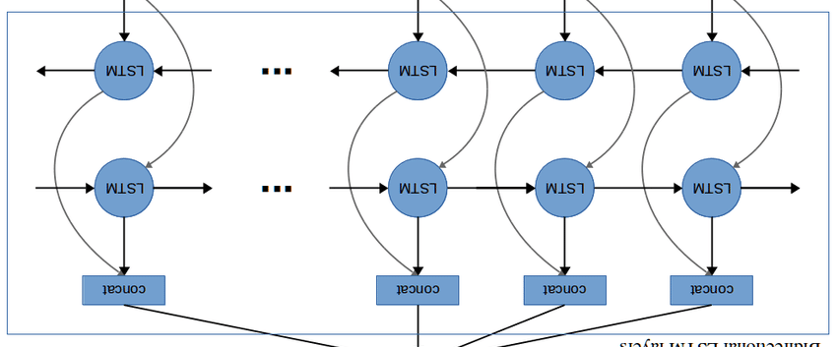
Bi-LSTM Model: Long Short Term Memory
Preprocessing
Tokenizer
Word embedding
Modeling
array([[ 0. , 0.0231 , 0.017 , 0.0157, ..., 0.13015001, -0.18317001, 0.1323],[-0.0175 , -0.2189 , 0.0353 , ..., 0.082745 , 0.097801 , 0.25044999],[-0.25909999, -0.2976 , -0.0327 , ..., 0.058326 ,-0.22751001, -0.34209001],[-0.25909999,-0.2976 , -0.03ة](
LSTM
LSTM
LSTM
LSTM
In the last step we input the result into our bi-LSTM model
LSTM
LSTM
LSTM
LSTM
Kaggle submission Bi-LSTM: 0.7483 AUC
Classifier output

Slide 15
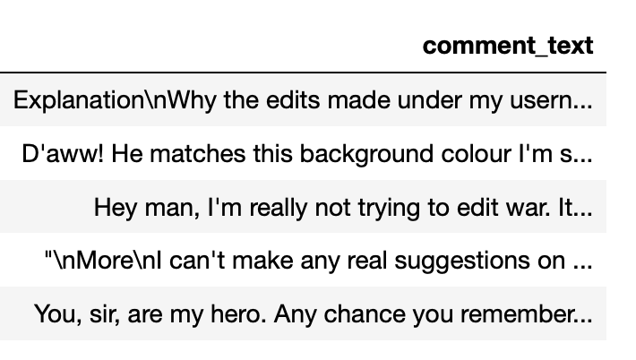
BERT and XLM-R Models
Auto-Tokenizer
Encode
Modeling
Initiate a pre-train Bert tokenizer class instance to tokenize the comment. The difference here is Bert tokenizer split the sentence into sub-words and character to help us to map each word to unique vector.

Slide 16
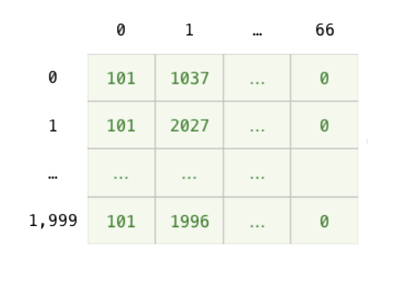
BERT and XLM-R Models
Auto-Tokenizer
Encode
Modeling
In Encode we take the words from our previous step and map every word to into context vector, and what the difference between word embedding and encoder is the encoder take consider the place of the word so the word in the beginning have different representation if it come in the middle or the last

Slide 17
BERT and XLM-R Models
Auto-Tokenizer
Encode
Modeling
We input the special [CLS] token that added at the first position into our Bert model. This token represent as a whole.
Bert or XLM-R
Kaggle submission for DistilBert: 0.8744 AUC
Kaggle submission for Bert: 0.8872 AUC
Kaggle submission for XLM-R: 0.9302 AUC
Classifier

Slide 18
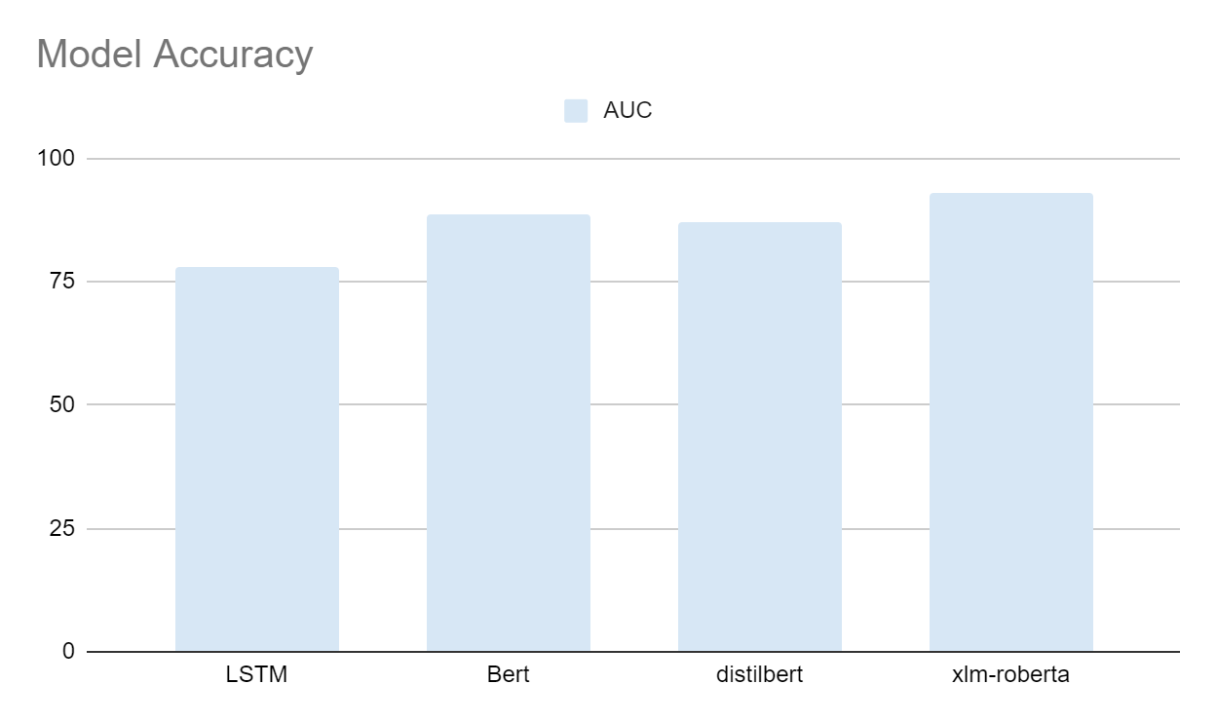
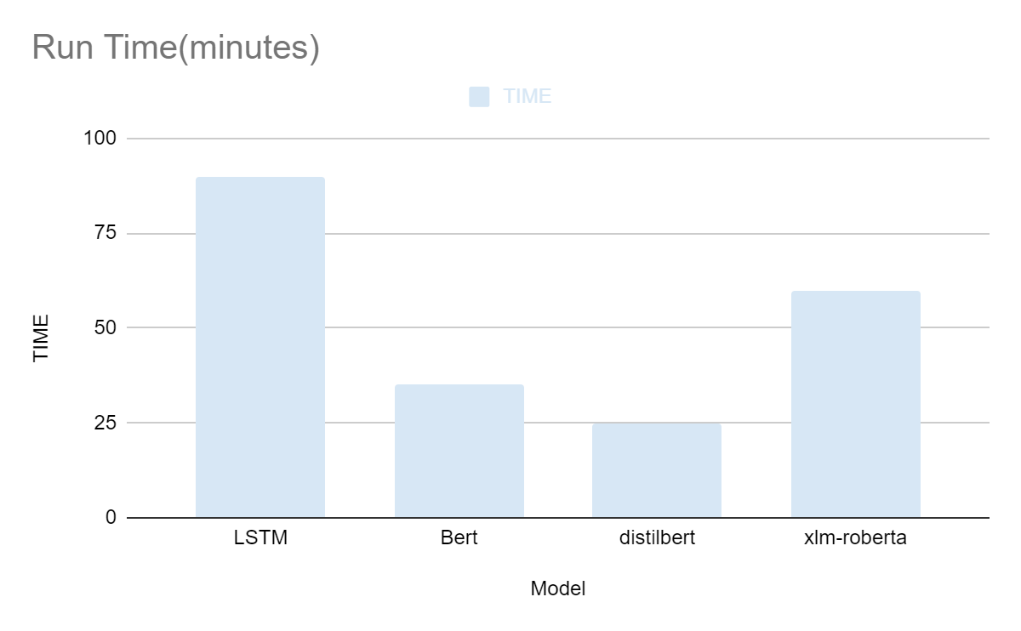
Model Performance Comparison

Slide 19
Comparison Between The Models
 | LSTM | BERT | DistilBert | XLM - R
Training Model | Need to be train | Already pre-train | Already pre-train | Already pre-train
Languages | English* | Train on 104 languages with Wikipedies | Train on 104 languages with Wikipedies | Trained on 100 languages with common Crawl
Word Embedding | Static word embedding | Context word embedding | Context word embedding | Context word embedding
Run | Sequential | Simoustanly | Simoustanly | Simoustanly
Running Time | Slower | Faster than LSTM | Faster 60% than Bert, preserving over 95% of Bert’s | Faster than LSTM, but slower than Bert

Slide 20

System ChatBot Prototype
In order to clarify the purpose of our model and how it can be used, we created a prototype chatbot allowing us to see how this project will be implemented in the future.
Chatbot
Please keep this slide for attribution.

Slide 21

Challenges We Faced
Emoji
Imbalance Data
Punctuation
[Bu arada önemli değil 😊 Kullanıcı]
0 1
[F**K ALL RIDES AT WORLDS OF FUN ]

Slide 22

Conclusion
Nowadays social media companies started to used machine learning technology to help them identify and ban violent extremism to grow more friendly, thriving environment

Slide 23

Recommendation & Future Works
Identifying comments with suicidal idea & self- harming behavior
Implementing it on social media to enhance their environments and eliminate toxicity conversation
Applying it to children phone to identify and delete the toxicity texts.

Slide 24

Thank you For Listening

Slide 25
REFERENCES
Research:
RoBERTa: A Robustly Optimized BERT Pretraining Approach
BERT: Pre-training of Deep Bidirectional Transformers for Language Understanding
Book:
Intelligent Computing and Optimization: Proceedings “multilingual word Embedding”
Articles:
What is Natural Language Processing? Introduction to NLP
The Illustrated BERT, ELMo, and co
The Illustrated Transformer
A Visual Guide to Using BERT for the First Time
A deep dive into multilingual NLP models
YouTube:
NLP for Developers: Transformers | Rasa
NLP for Developers: BERT | Rasa

